Slide 1
TCP Servers

Slide 2
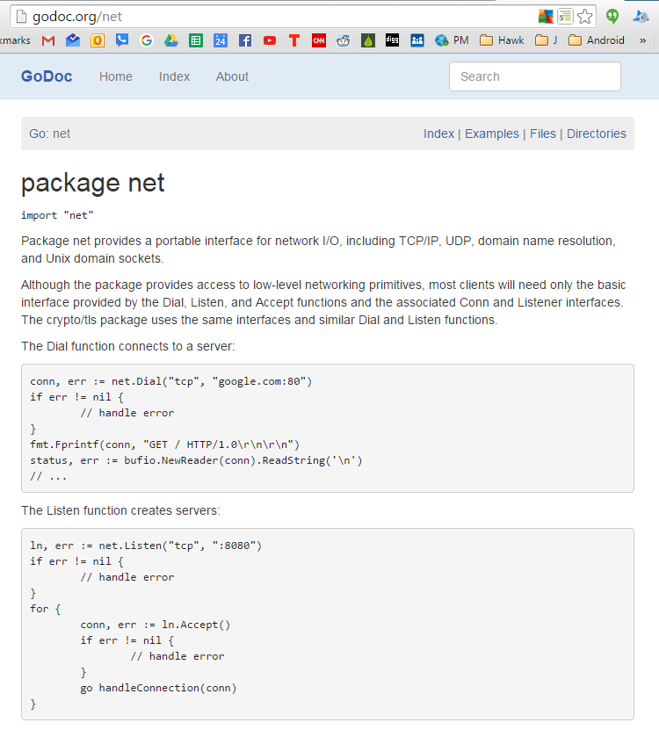

Slide 3
ports
place where things come in and go out
https://en.wikipedia.org/wiki/List_of_TCP_and_UDP_port_numbers

Slide 4
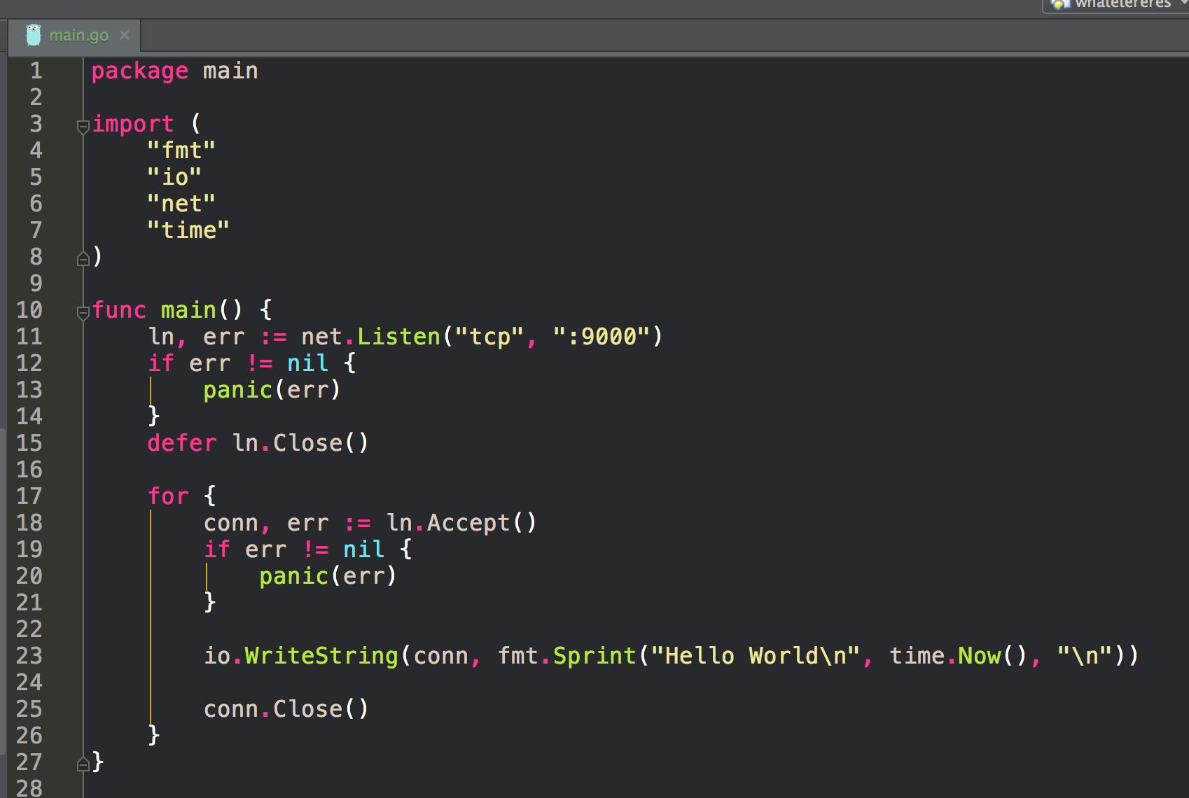
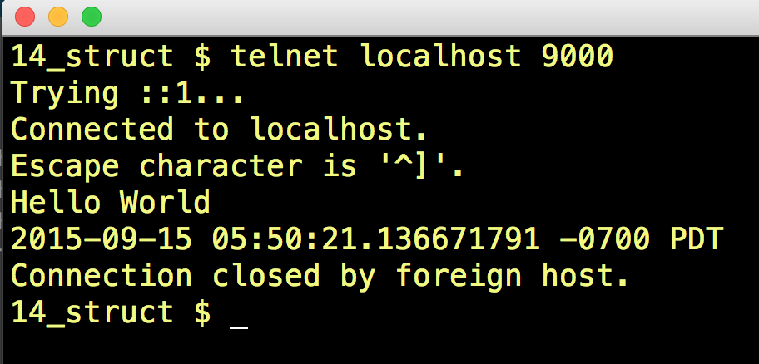
telnet is a tcp client

Slide 5
ctrl+c
to exit program

Slide 6
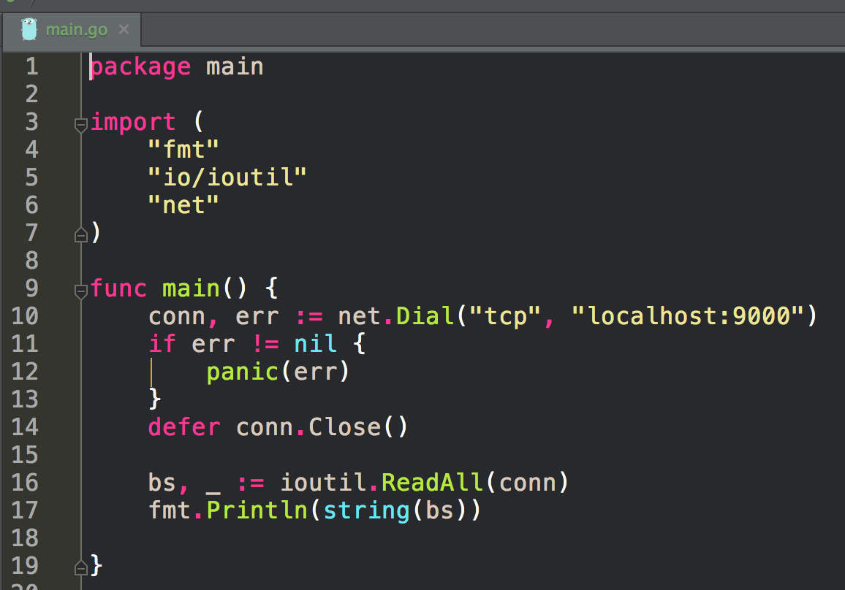
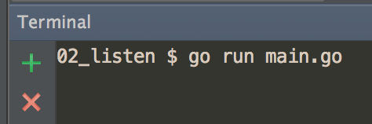
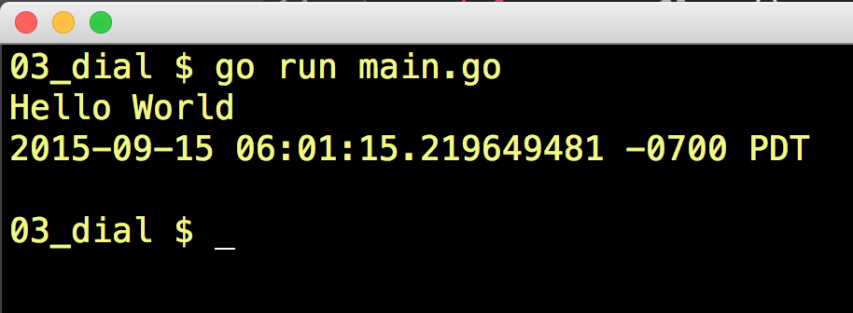
1 - listen
2 - dial

Slide 7
1 - listen
We have two separate programs running and they’re communicating over TCP
2 - dial

Slide 8
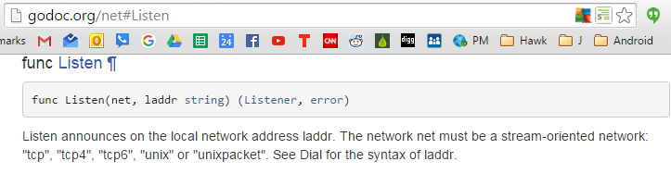
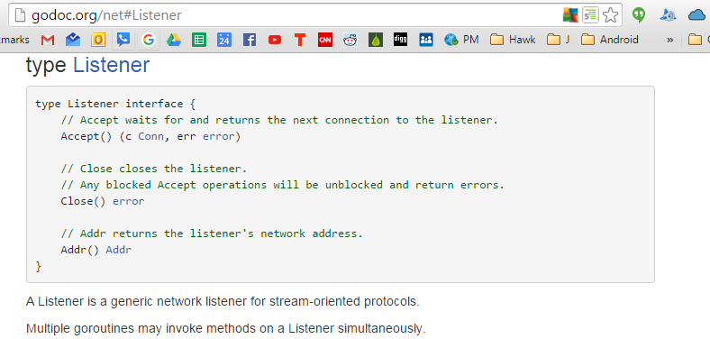

Slide 9
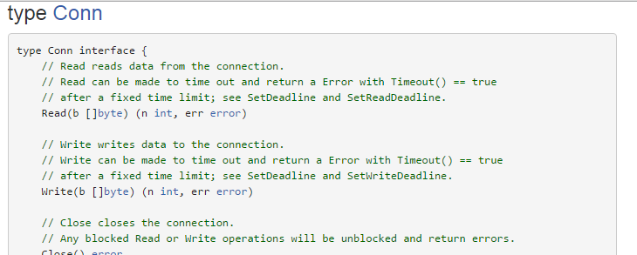

Slide 10
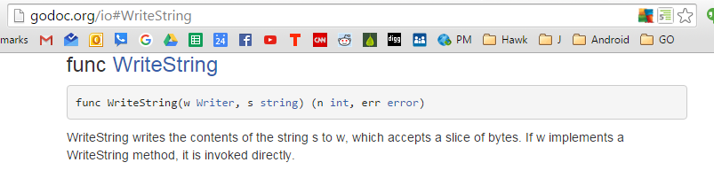

Slide 11
exercises

Slide 12
tcp echo
Create an ‘echo’ TCP server. It should accept a connection and write to the connection anything that’s sent to it.

